Slide 1
Employee Attrition Analysis
Presented By
Anant Anugrah Tudu

Slide 2

Introduction
XYZ Company is currently facing a significant challenge with a 15% annual employee attrition rate, impacting various facets of its operations. To address this issue, a comprehensive HR analytics project has been initiated to understand the underlying reasons behind employee departures and to formulate effective retention strategies.

Slide 3
Details of Data
EmployeeID: Unique identifier for each employee.
Age: Age of the employee.
Attrition: Whether the employee has left the company (Yes or No).
BusinessTravel: Frequency of travel for work (Travel_Rarely, Travel_Frequently, Non-Travel).
Department: Department in which the employee works (Sales, Research & Development, Human Resources).
DistanceFromHome: Distance of employee's residence from work in miles.
Education: Employee's level of education (1 to 5, representing varying levels).

Slide 4
EducationField: Field of education of the employee (Life Sciences, Medical, Marketing, etc.).
EmployeeCount: Number of employees (usually 1 in most records).
Gender: Gender of the employee (Male or Female).
JobLevel: Level of the job (1 to 5, indicating different hierarchical levels).
JobRole: Role/title of the employee (Sales Executive, Research Scientist, Laboratory Technician, etc.).
MaritalStatus: Marital status of the employee (Single, Married, Divorced).
MonthlyIncome: Monthly income of the employee in USD.
NumCompaniesWorked: Number of companies the employee has worked for previously.
Over18: Whether the employee is over 18 years old (Y for all records).
PercentSalaryHike: Percentage increase in salary last year.
StandardHours: Standard number of working hours (80 for all records, assuming full-time).

Slide 5
KPI
Attrition Rate: Calculate the percentage of employees who have left the company (Attrition = Yes) compared to the total number of employees.
Average Age: Average age of employees in the company.
Average Monthly Income: Average monthly income of employees.
Average Distance From Home: Average distance of employees' residences from their workplace.
Average Years at Company: Average number of years employees have worked at the company.
Average Years Since Last Promotion: Average number of years since employees' last promotion.
Turnover Rate by Department: Percentage of employees who have left the company within each department.

Slide 6
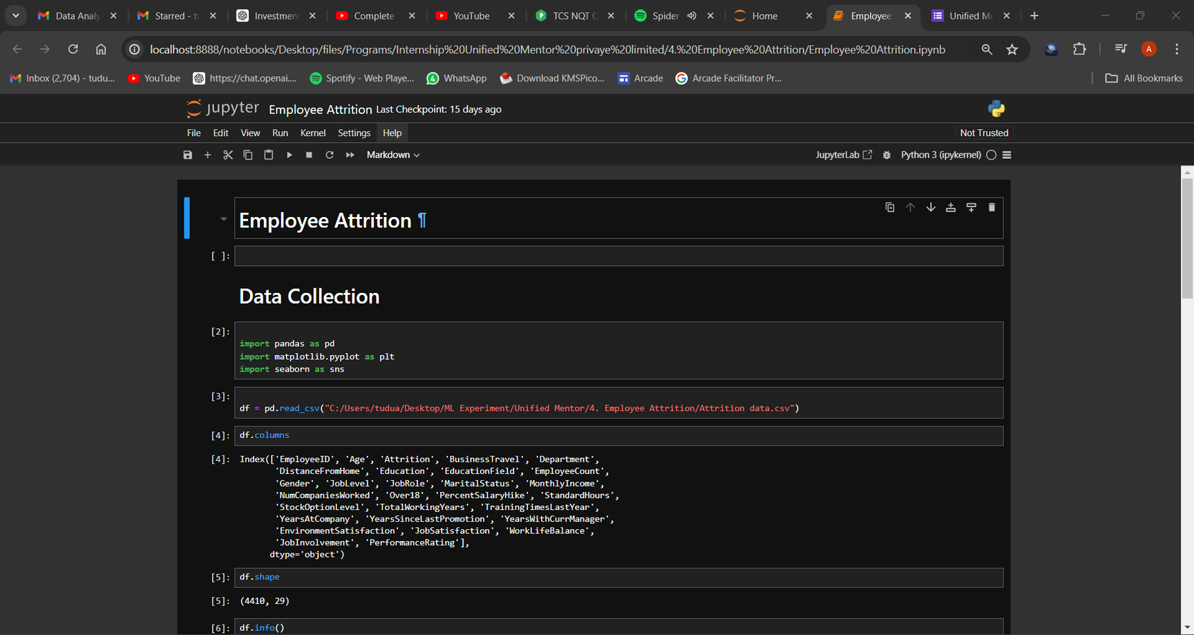
Screenshots

Slide 7
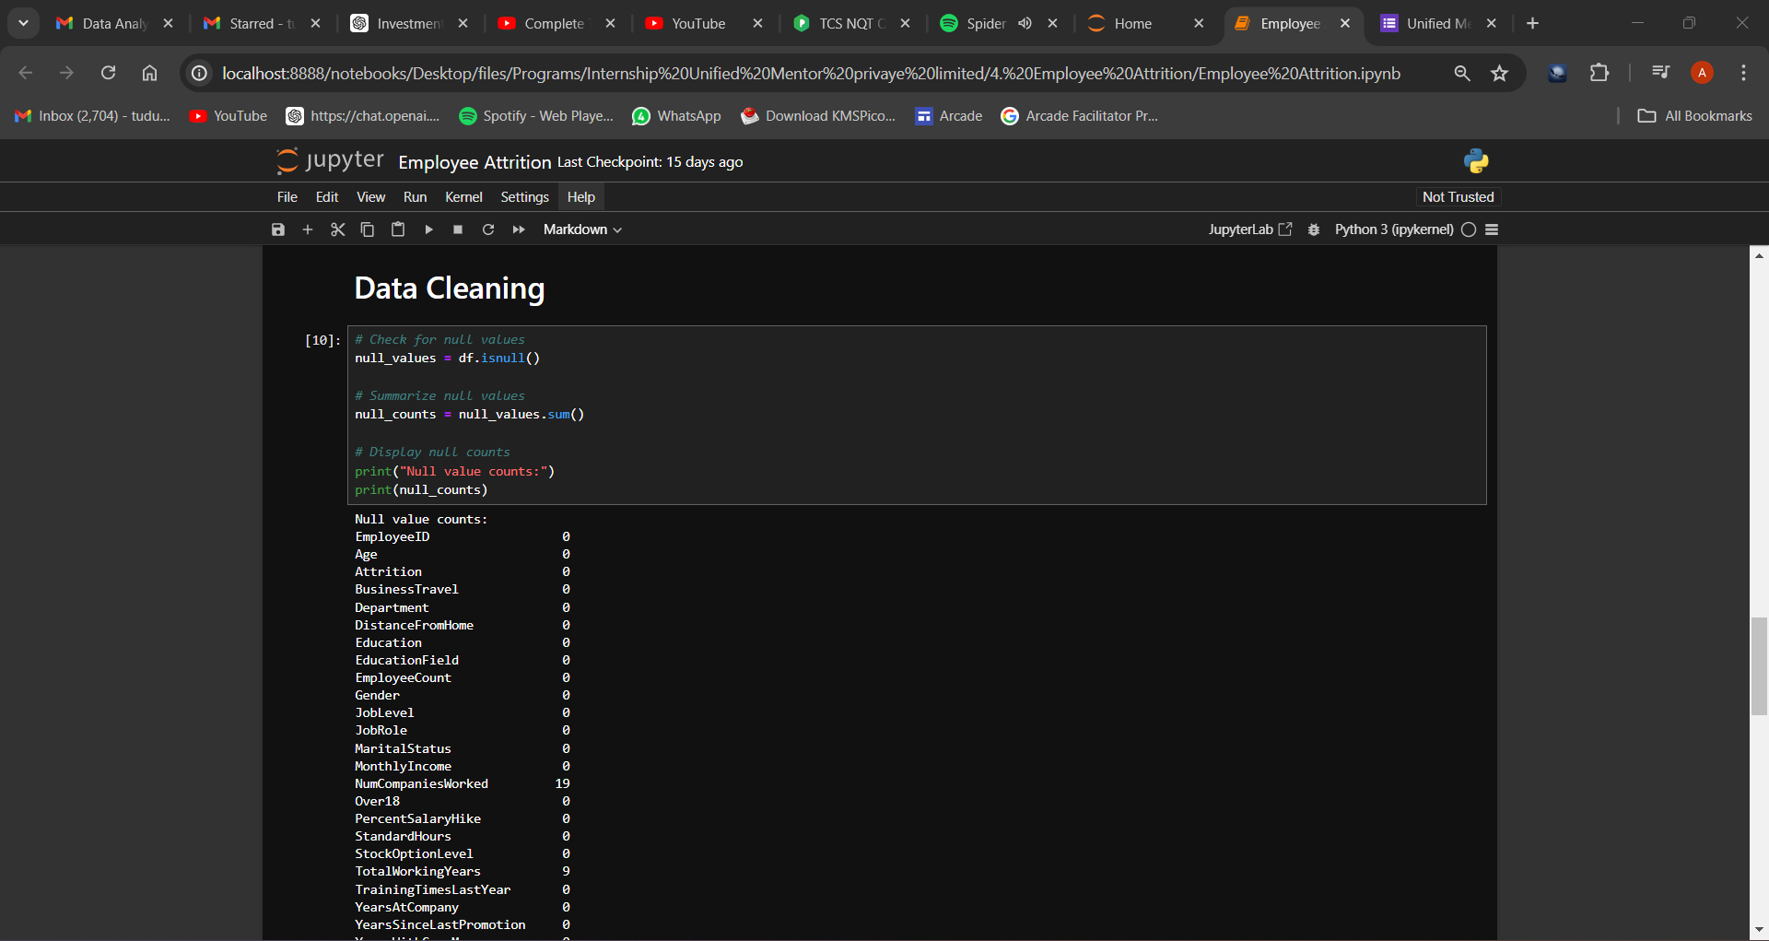

Slide 8
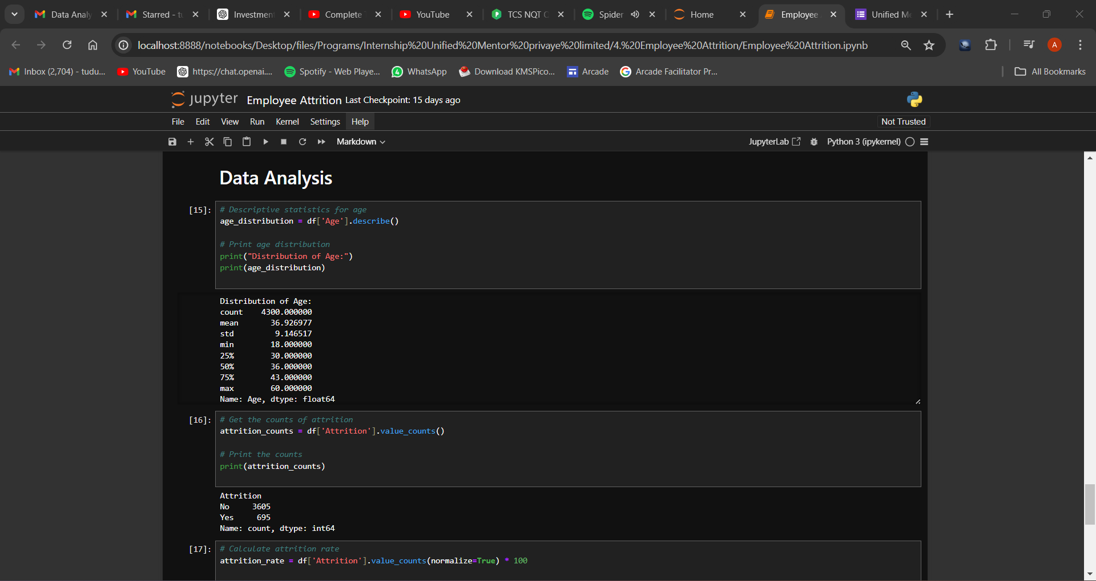

Slide 9
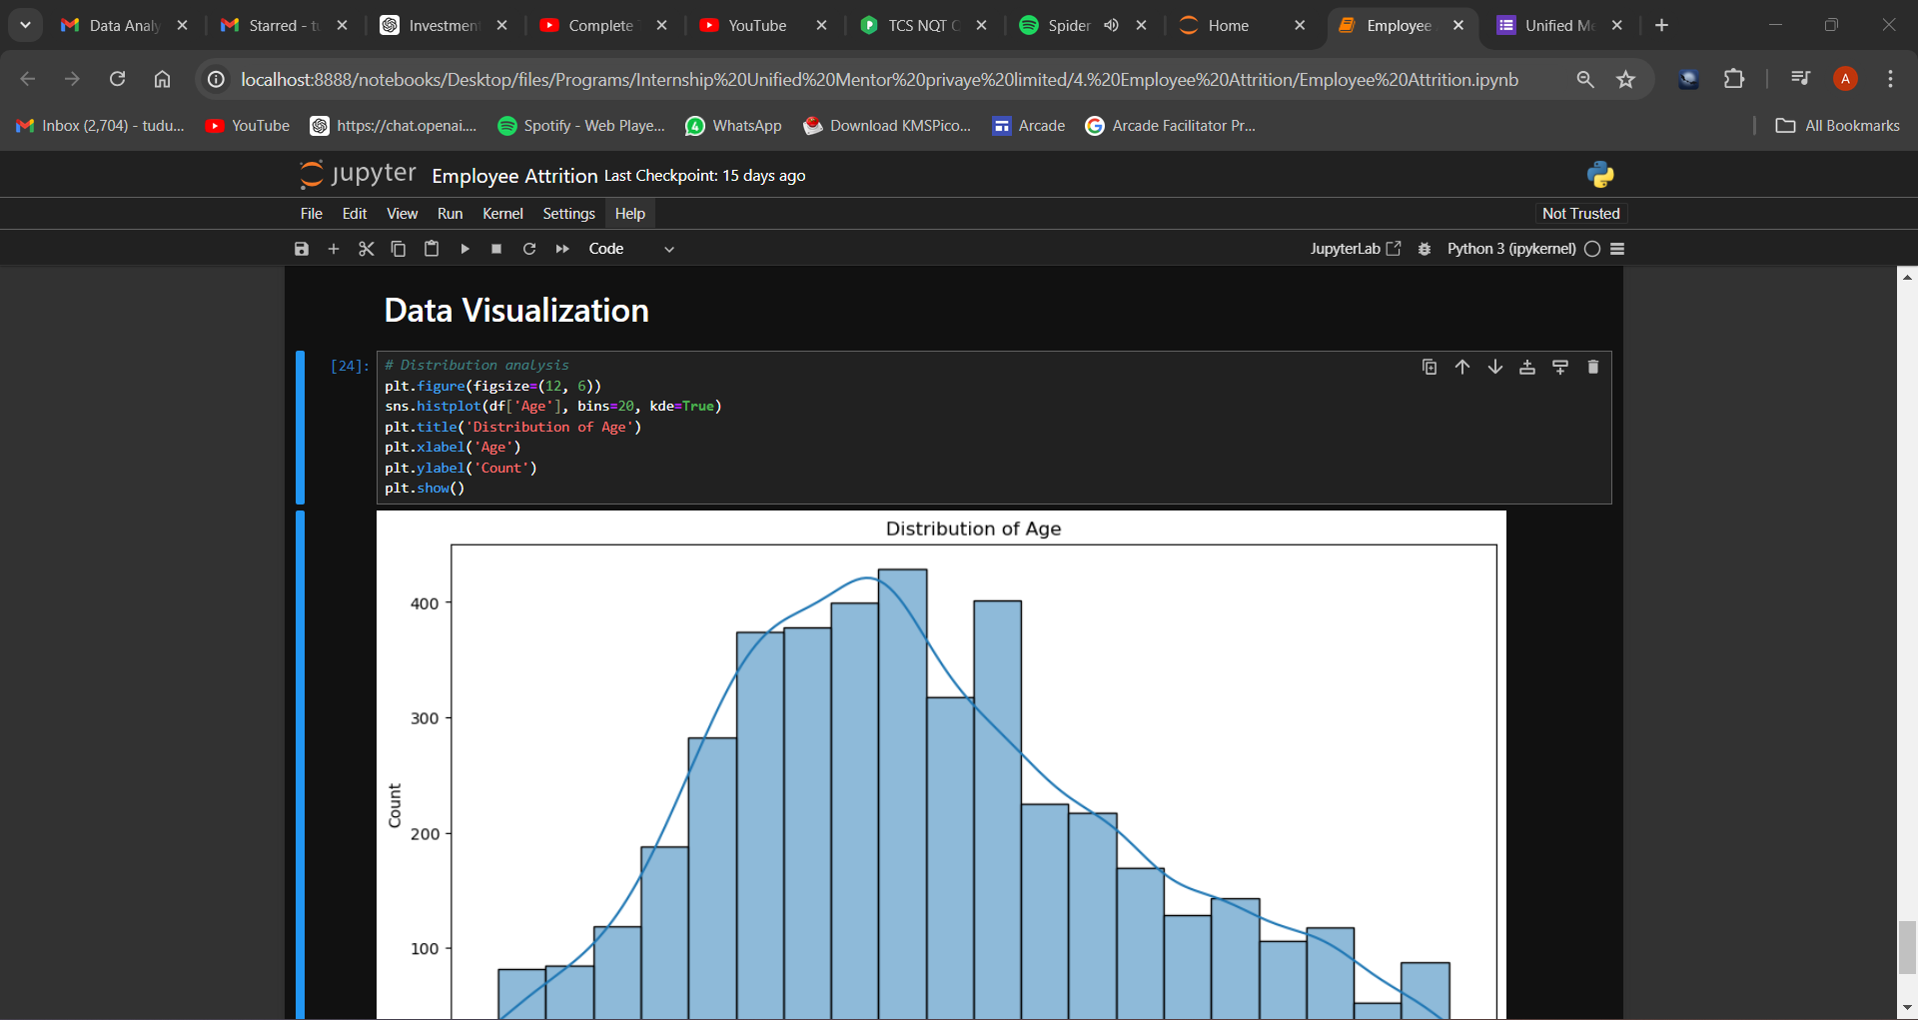

Slide 10
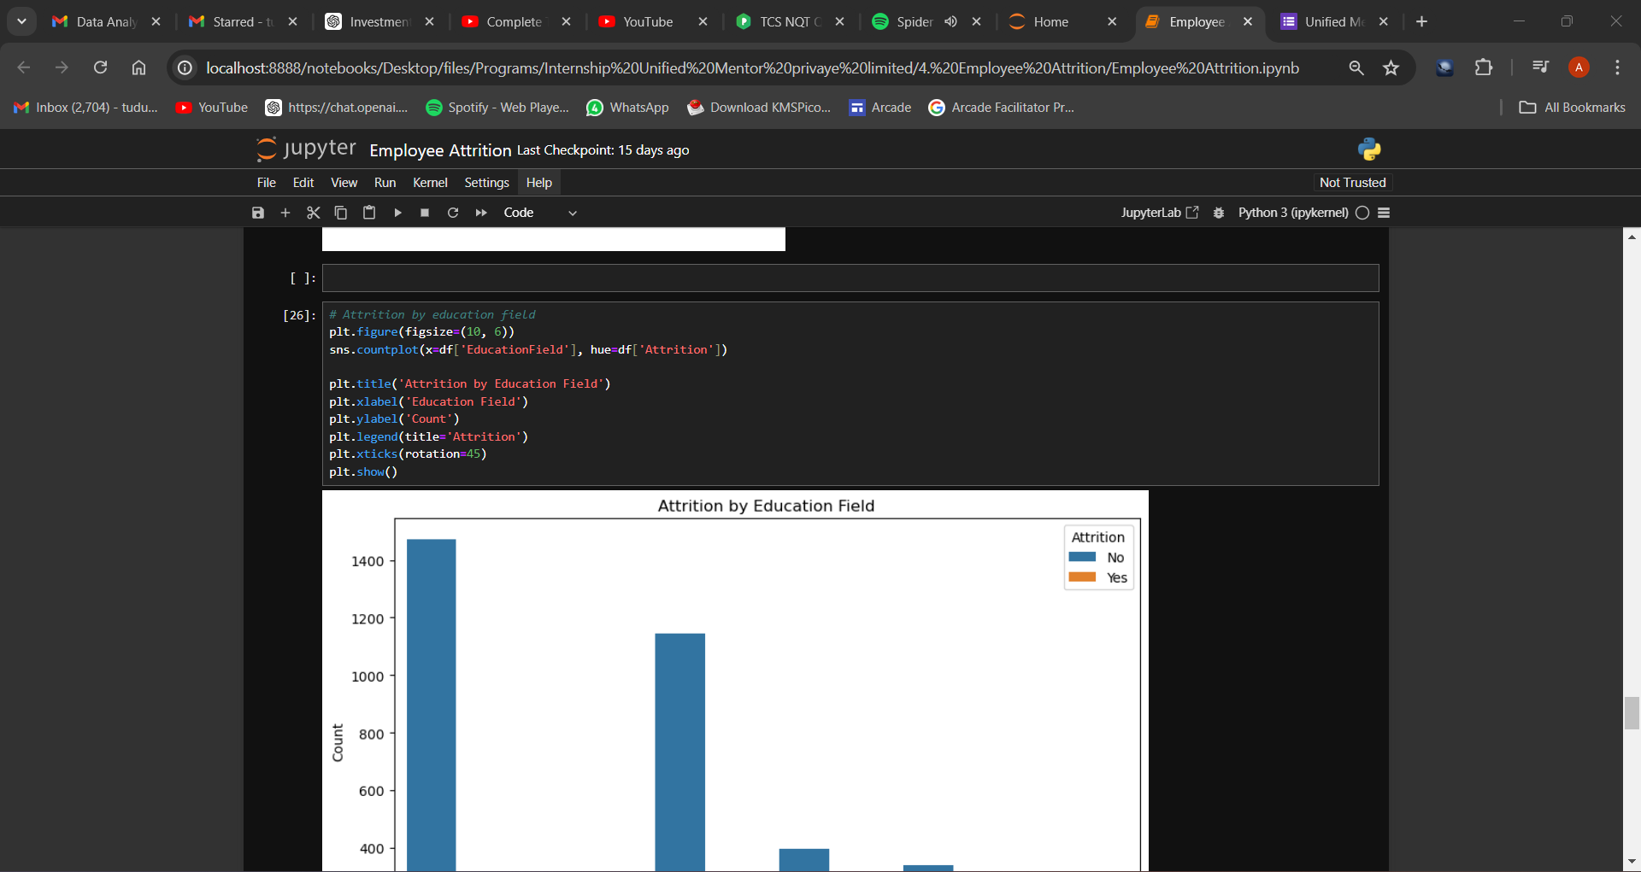

Slide 11
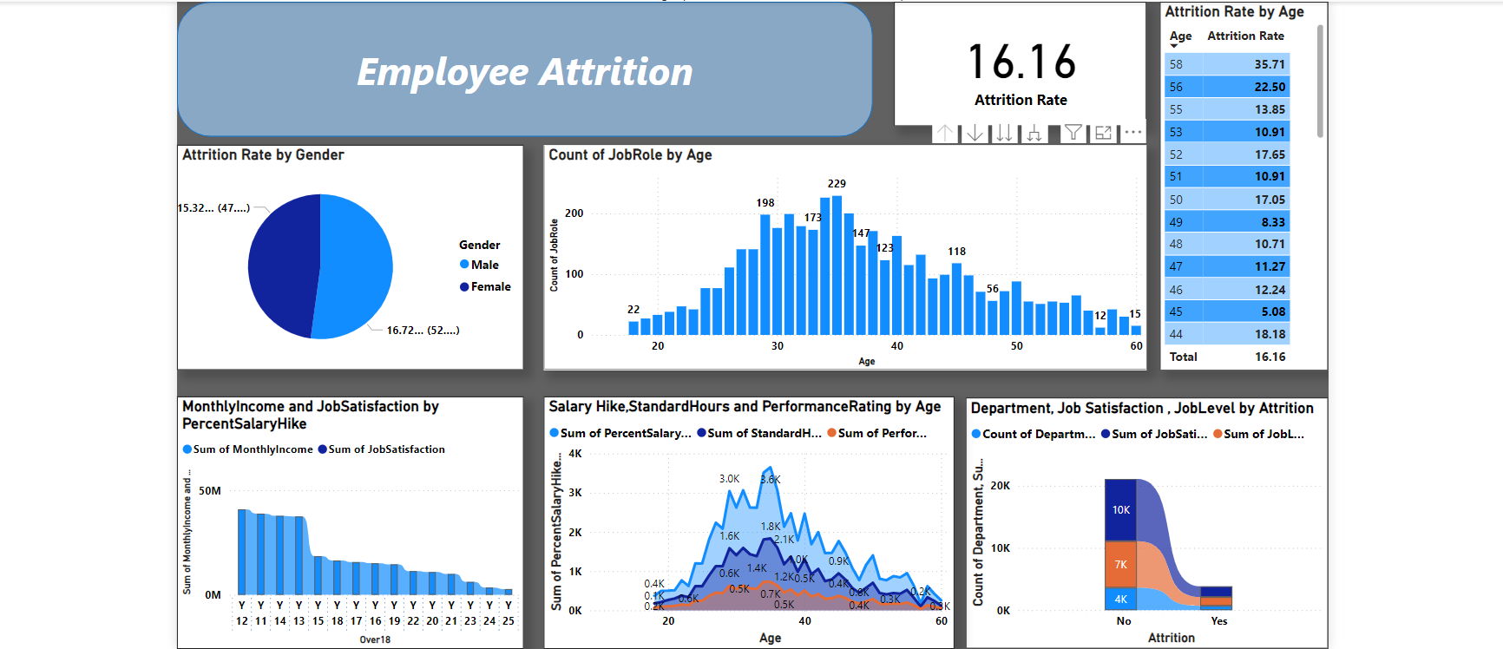
Dashboard

Slide 12
Insights
The attrition rate in XYZ company is approximately 15%, which indicates a significant turnover that needs attention.
The workforce shows a diverse age distribution, with a majority likely in their mid-career stages based on average age trends.
There is variability in monthly income levels among employees, reflecting different roles and experience levels within the company.
Employees seem to live relatively close to the workplace on average, which may impact commuting satisfaction and retention.
The average tenure at the company is moderate, suggesting a mix of new hires and longer-tenured employees.
There is a varied distribution in years since the last promotion, indicating potential dissatisfaction with career progression opportunities.
Distribution across education levels and gender shows a diverse workforce composition, which may influence attrition patterns.

Slide 13
Thank you!

